Slide 1
Smart bus system which has functions of waiting time estimation and special passengers tracking
Group members:
Emmanuel Sedicol
Jingwen Jiang
Jianing Tan

Slide 2
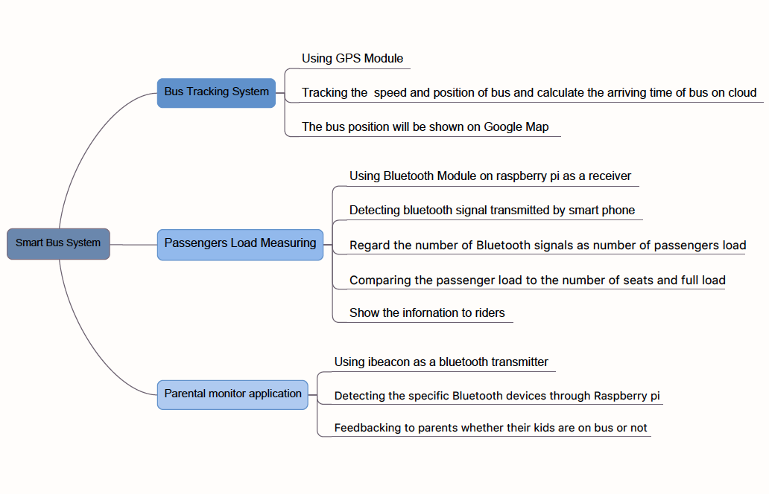
mind map

Slide 3
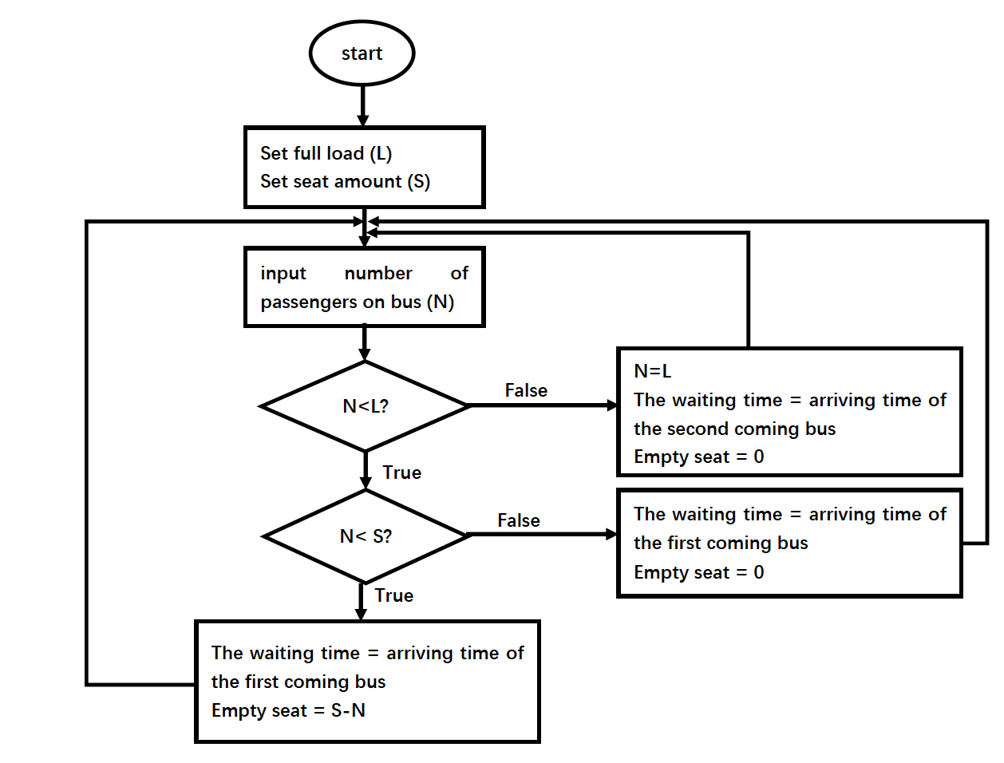
Flow chart of potential algorithm

Slide 4
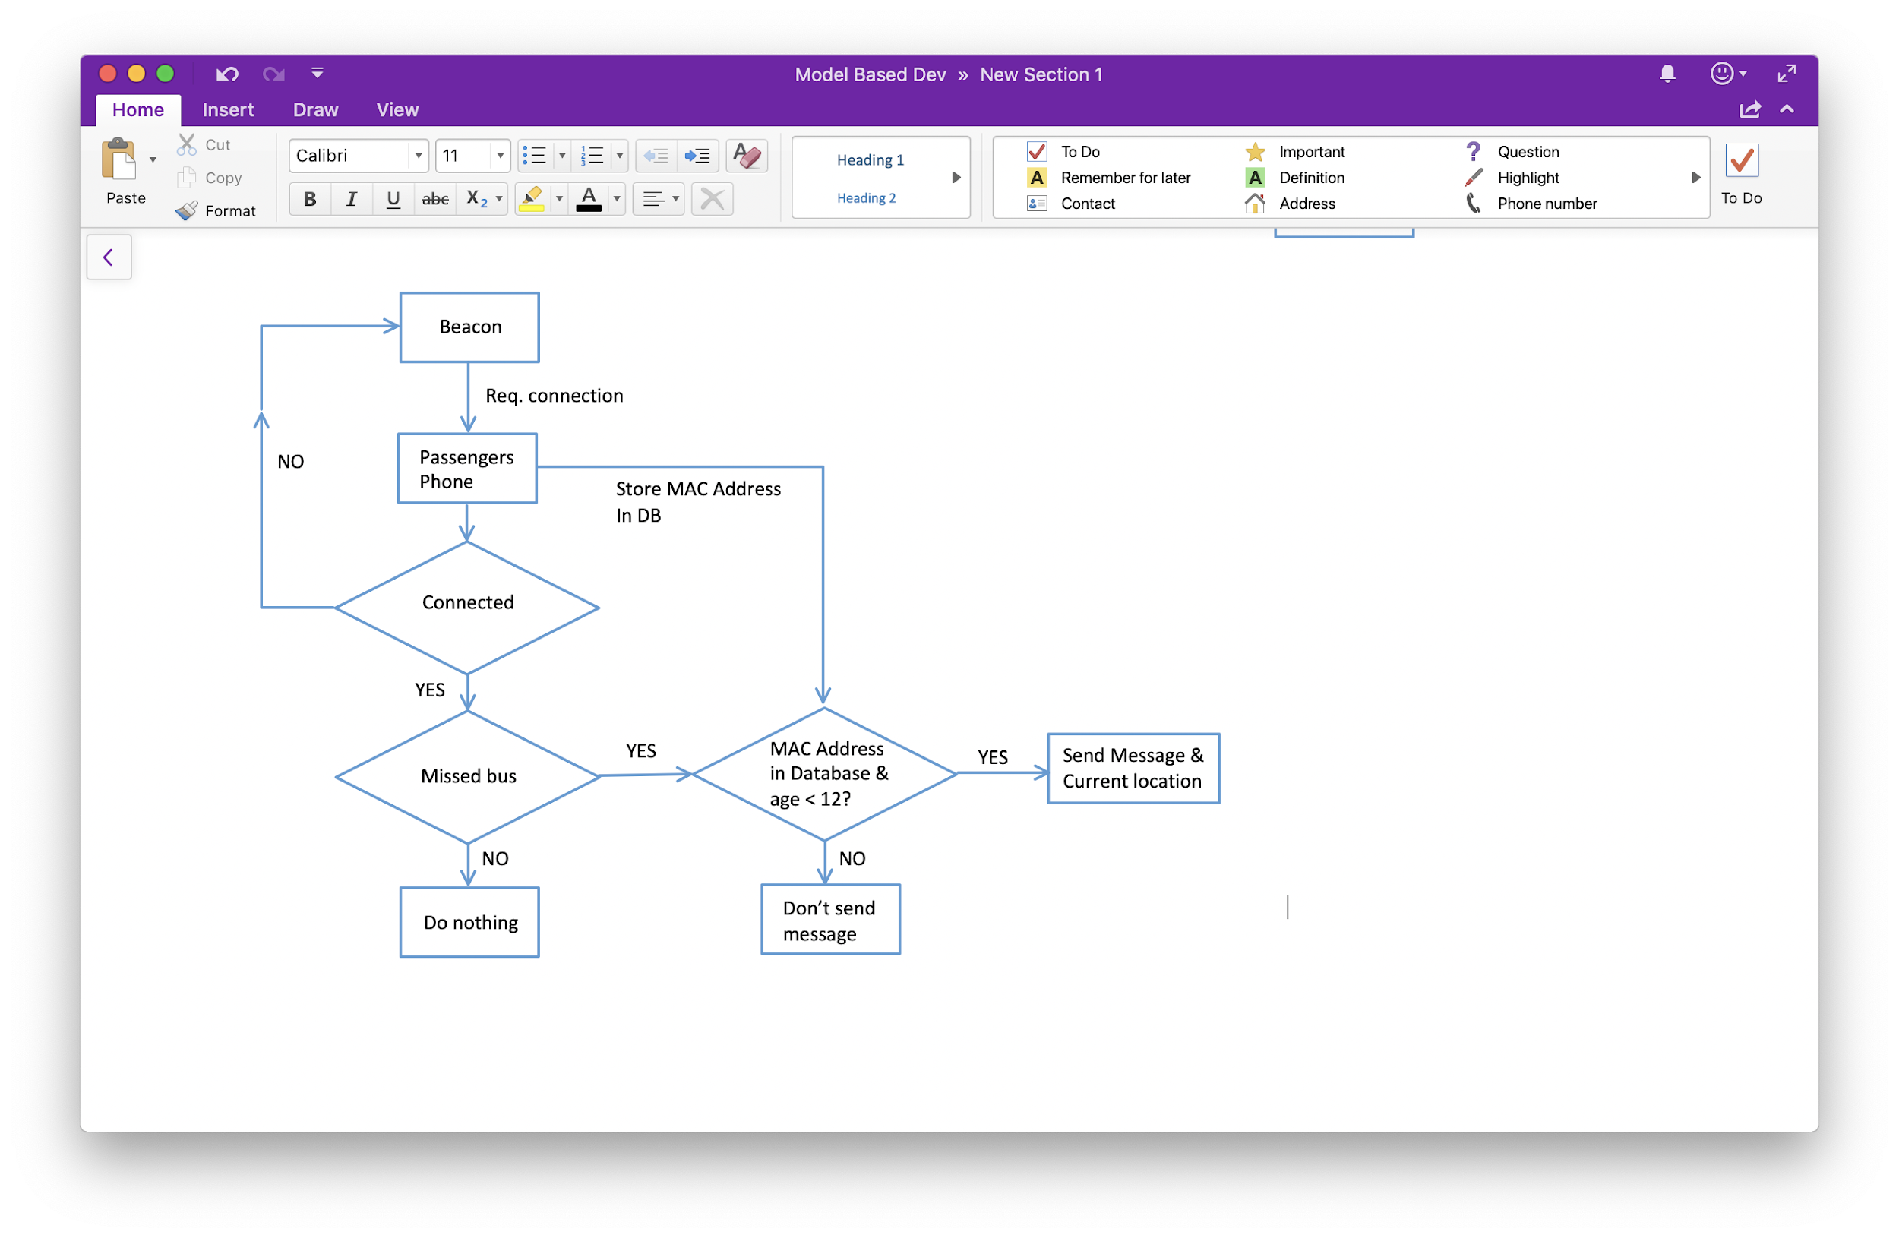
Parental Monitor
- A small phone app will be created.
- The parents can register their children on the app with their children's personal info and MAC address on their device.
- Information on registration will be stored on a database.

Slide 5
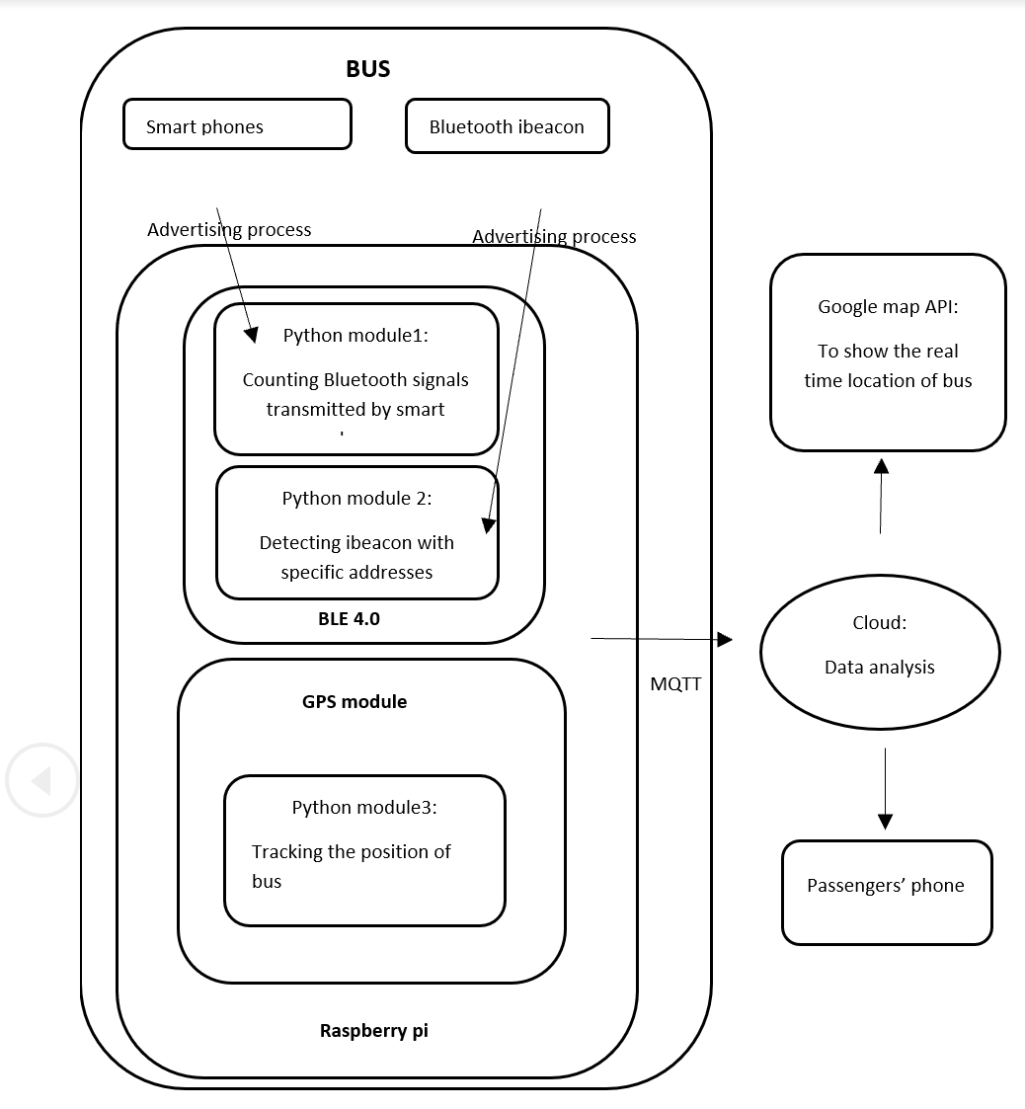
Informational flow diagram

Slide 6
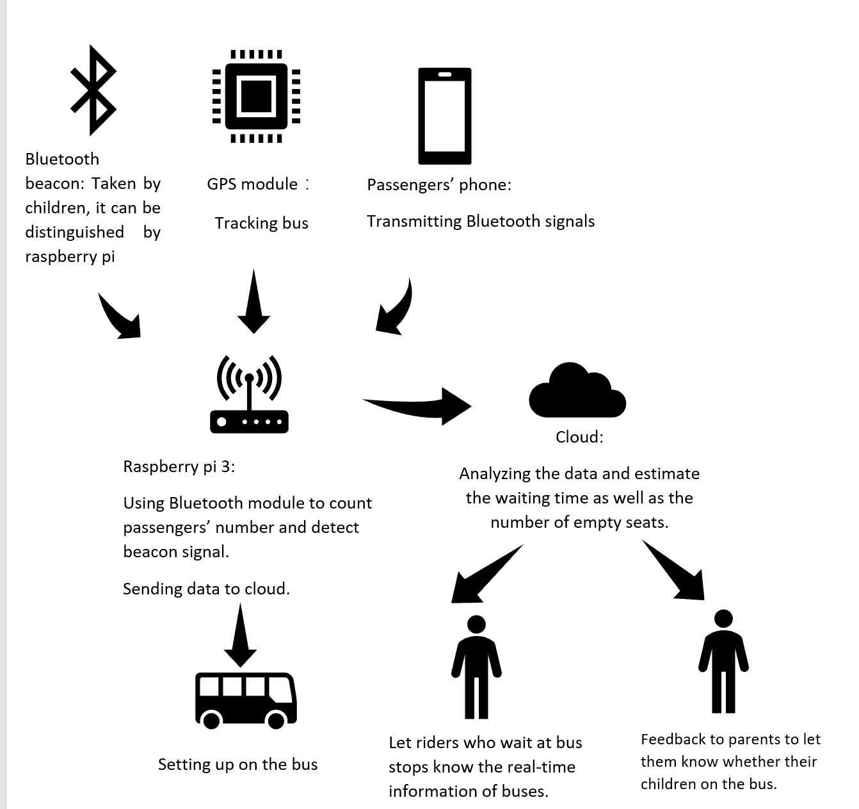
Pictorial representation of project

